Slide 1

A Systematic Literature Review on the Effect of Code Smells on Non-Functional Attributes of Source Code
Università degli Studi di Salerno
Dipartimento di Informatica
Nazira Munalbayeva
University of Salerno
n.munalbayeva@studenti.unisa.it

Slide 2
Systematic literature review process
1. Identify need for SLR
2. Develop Review Protocol
3. Specify Research Questions
4. Search strategy design
5. Study selection criteria
6. Study quality assessment
7. Data Extraction
8. Data Synthesis
9. Reporting the results
10. Validate Report
Plan review
Conduct review
Document review

Slide 3
Motivation
We are interested in how big is the impact of code smells in a project, for understanding if is really worth working for individuating and refactor code smells or this operation can be neglected. Goals -Conduct a systematic analysis of academic articles on "The Effect of Code Smells on Non-Functional Attributes of Source Code". -Analyse and synthesize results to answer research questions.
1. Identify need for SLR

Slide 4
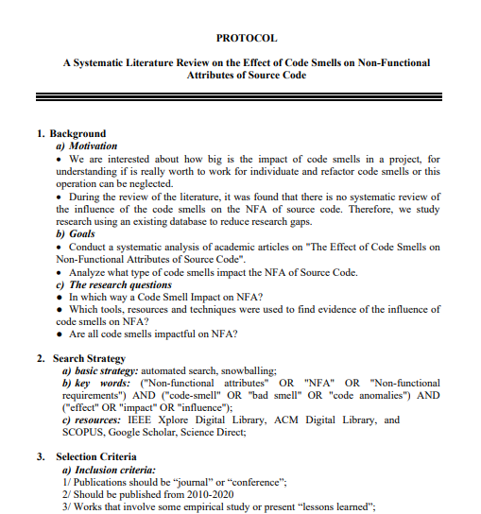
The review protocol that included the following steps: research questions identification, search strategy design, study selection criteria, study quality assessment, data extraction process and data synthesis process.
2. Develop Review Protocol

Slide 5
3. Specify Research Questions
In which way a Code Smell Impact on NFA?
How the connection between code smells and NFA was determined?
Are all code smells impactful on NFA?
We aim to answer the following research questions by conducting a methodological review of existing research.

Slide 6
4. Search strategy design
The following steps were used to construct the search terms:
(a) Derive major terms from the research questions.
(b) Identify alternative spellings and synonyms for major terms.
(c) Check the keywords in relevant papers.
(d) Use the Boolean OR to incorporate alternative spellings and synonyms.
(e) Use the Boolean AND to link the major terms.
The search string below was applied to 4 digital libraries: IEEExplore, Scopus, ACM, Elsevier.
Key words:
("Non-functional attributes" OR "NFA" OR "Non-functional requirements") AND ("code-smell" OR "bad smell" OR "code anomalies") AND ("effect" OR "impact" OR "influence") (“Antipatterns” OR “APs” OR “Anti-pattern”)

Slide 7
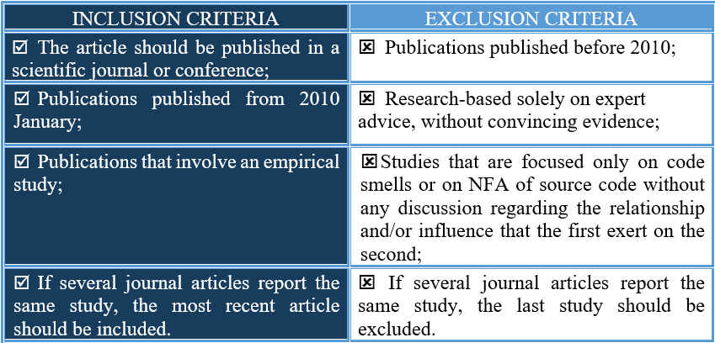
5. Study selection criteria

Slide 8
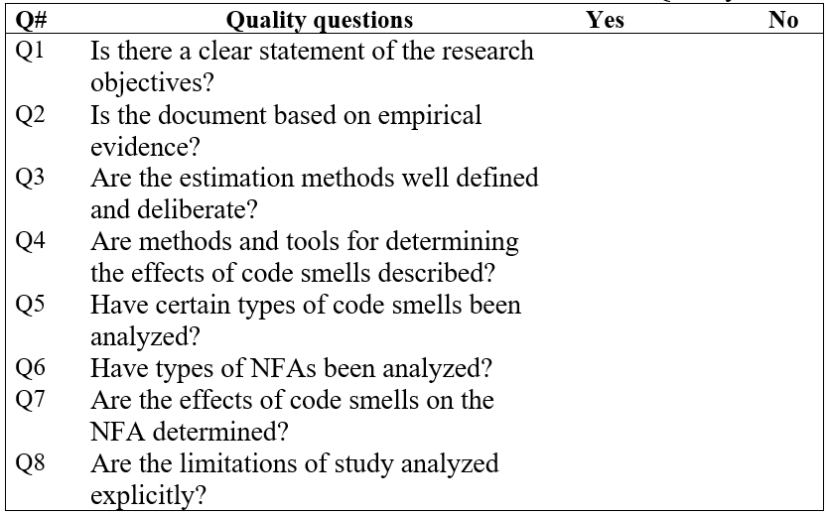
Research papers that can answer all quality assessment questions positively were included in the SLR. Finally, after careful reviews, discussions, and brainstorming sessions, the final decision on inclusion / exclusion for each study was made.
6. Study quality assessment
EXCLUDED 9 STUDIES

Slide 9
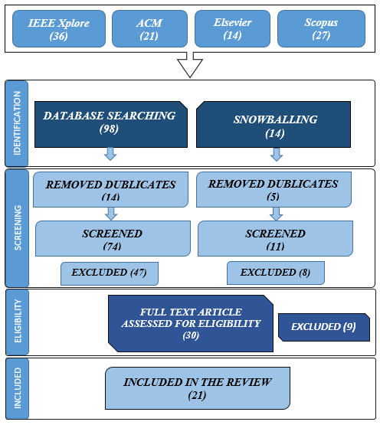
Study selection process

Slide 10
7-8. Data Extraction & Synthesis
The data extraction forms must be designed to collect all the information needed to address the review questions and the study quality criteria.
The goal of data synthesis is to aggregate evidence from the selected studies for answering the research questions.
identification number;
year;
title;
objectives or aims;
code smells;
analysed projects;
research questions and respective answers;
In which way a Code Smell Impact on NFA?
How the connection between code smells and NFA was determined?
Are all code smells impactful on NFA?
software projects or method that illustrate this influence.

Slide 11
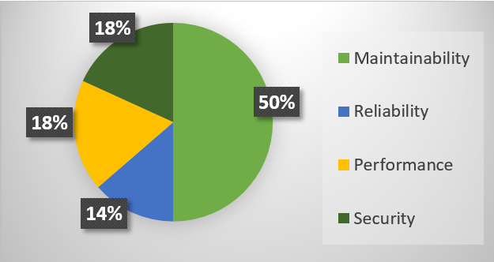
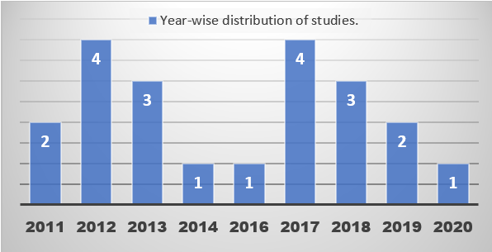
RESULTS AND DISCUSSION OVERVIEW OF SELECTED STUDIES
9. Reporting the results
Percentage of included attributes in the review %.
Timeline distribution of papers

Slide 12
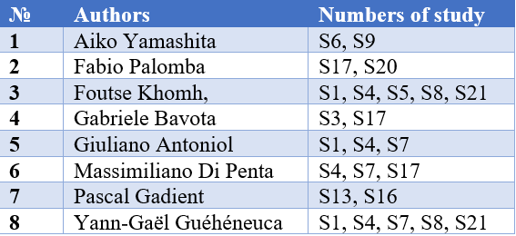
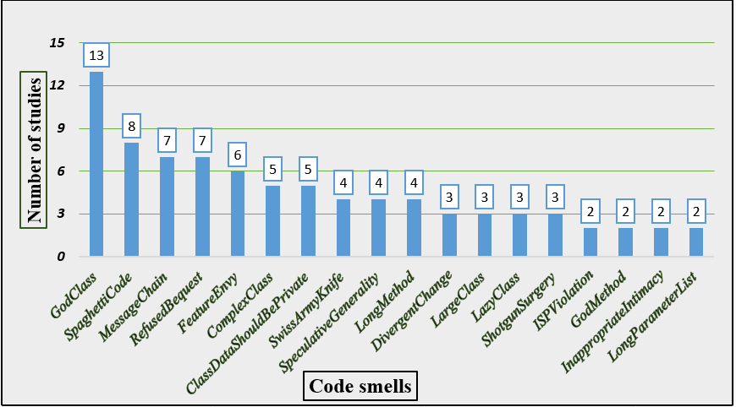
RESULTS AND DISCUSSION OVERVIEW OF SELECTED STUDIES
9. Reporting the results
Active authors that researching relationships between NFAs and code smells
Number of articles that studied code smells impact

Slide 13
RQ1: In which way a Code Smell Impact on NFA?
Maintainability, performance, and security are more affected by code smells. The code smells that most affect different quality non-functional attributes are GodClass, LongMethod, SpaghettiCode and FeatureEnvy. GodClass most affects attribute quality. This affects maintainability, complexity, changeability, and performance.
Code smells of the Android system, e. g. Getter / Setter (IGS), MemberIgnoringMethod (MIM), and HashMapUsage (HMU) mostly affect performance aspects like user interface, Energy Consumption, and memory performance.
Code smells on security can slow down the development process and can increase the risk of faults and crashes. Thus, it will increase the risks of software security vulnerabilities. The most impactful code smells on security is DenialofService, IntentSpoofing, IntentHijacking.

Slide 14
RQ2: How the connection between code smells and NFA was determined?
To answer the RQ2 we focused on the frequent methods that were used in research papers to determine the effect of code smells on NFAs. There is still no universal method to detect all types of code smells and also, in different systems, code smells differently exert their influence. These factors influenced the creation of different techniques and tools. In several studies, they used the refactoring method to find the connection between code smells and NFAs.

Slide 15
Are all code smells impactful on NFA?
Analyzing the results, we can conclude that code smells are not always the main cause of errors in the code. Sometimes some types of smells reduce faults. Also refactoring is not a absolute solution to improve the quality of the code.

Slide 16
10. Validate Report
This was resolved by defining a form of data mining to answer research questions. Conclusions and implications are based on the extracted data. Threats to internal validity were considered at the review selection stage. The studies included in this review were identified through a rigorous multi-stage selection process.
A risk of biased data extraction
In the present work, this was solved by specifying a research protocol that defines research questions and research objectives, inclusion and exclusion criteria, search strings that will be used in the information search strategy and data extraction strategy.
The bias in the choice of publications
The goal was not to get an exhaustive list of code smells that effect on NFAs. At least those that are more relevant and representative and, impact on software product qualities.
The bias is due to code smells

Slide 17
Conclusions
This project presents an overview that informs about the impact of code smells on NFAs. To systematize empirical studies, a systematic review was carried out in the databases IEEEXplore, ACM, Elsevier, and Scopus. 21 articles with experimental study designs met the criteria, and were analyzed in-depth.
As a result, we received answers to research questions that determined the impact on attributes as Maintainability, Reliability, Performance and Security. We found that Maintainability, performance, and security are more affected by code smells. Source code with code smells becoming more Fault-prone and change-prone. If the source code contains a combination of code smells, it most reduces the quality of non-functional attributes. Code smells on security can slow down the development process and can increase the risk of faults and crashes.
We determine that there is still no universal method to detect all types of code smells and also, in different systems, code smells differently exert their influence. These factors influenced the creation of different techniques and tools. In several studies, they used the refactoring method to find the connection between code smells and NFAs.
We concluded that code smells are not always the main cause of errors in the code. Sometimes some types of smells reduce faults. Also refactoring is not the absolute solution to improve the quality of the course code.

